Slide 1
Dicebot
Team 12 Tech-no Logic
Jamie Moseley, Yifan Shi, Chia-Yen Tsou

Slide 2
Link to github repo
https://github.com/mac785/ROS2-Dicebot
Requirements:
Webcam
Docker installation (don’t recommend building locally for reasons which will be explained later)
Game controller (we used a Dualsense 5)
Dice

Slide 3
Project Goals
The goal of this project was to have a robot move according to dice roll outcomes, all running in ROS2.
Using computer vision, the robot would identify the results of a dice roll. It would then sum the value of the opposite faces of the dice.
The robot would then signal the opposite-face sum by writing it out.
The robot used would be the Yahboom DOFBOT-Pro 6-Axis Arm

Slide 4
Things did not go as planned!

Slide 5
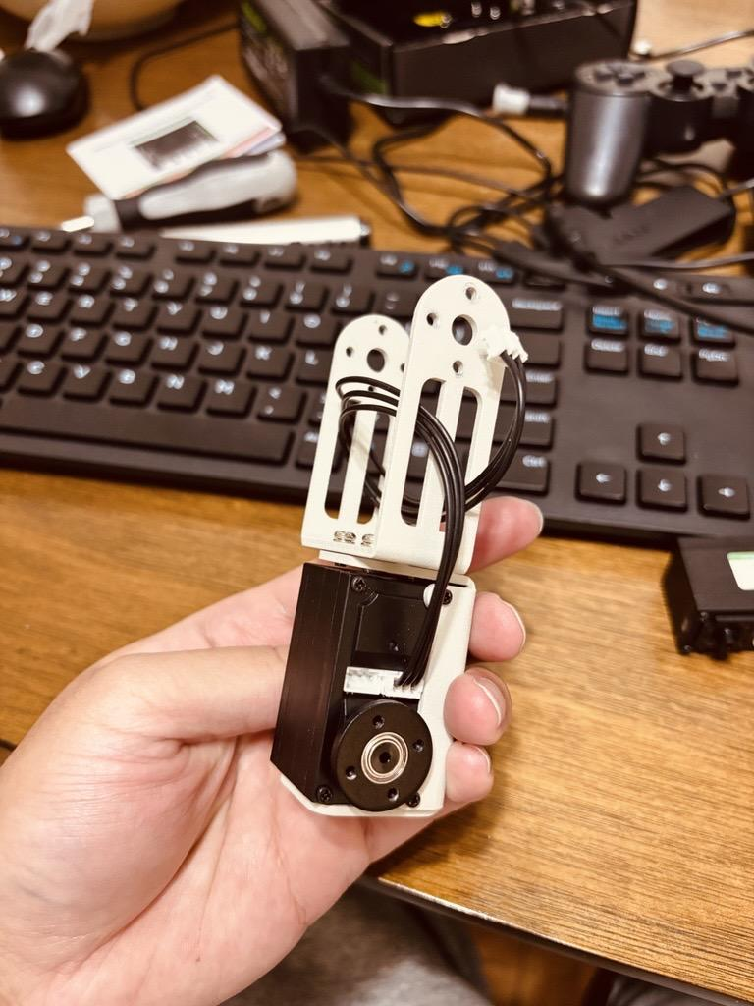
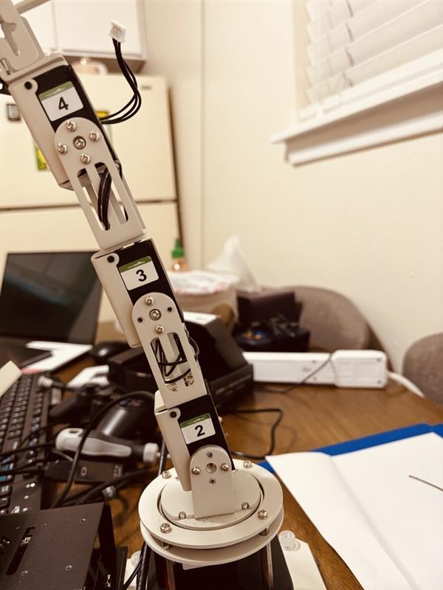
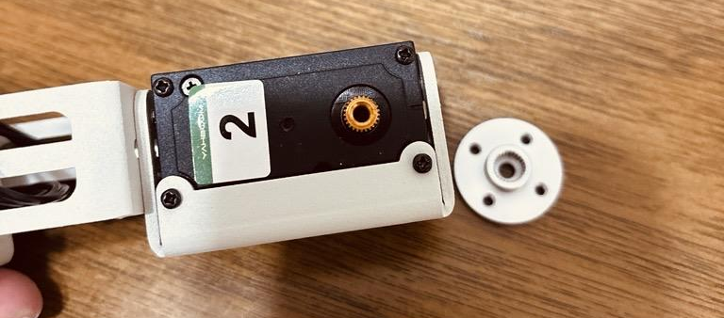
Roadblocks we faced
Broken/unreliable hardware
Outdated codebase (Based on ROS1)
Python version conflicts (Specifically as result of Ultralytics/YOLO)
Virtual environments (venv, conda, pixi, etc) did not work for us

Slide 6
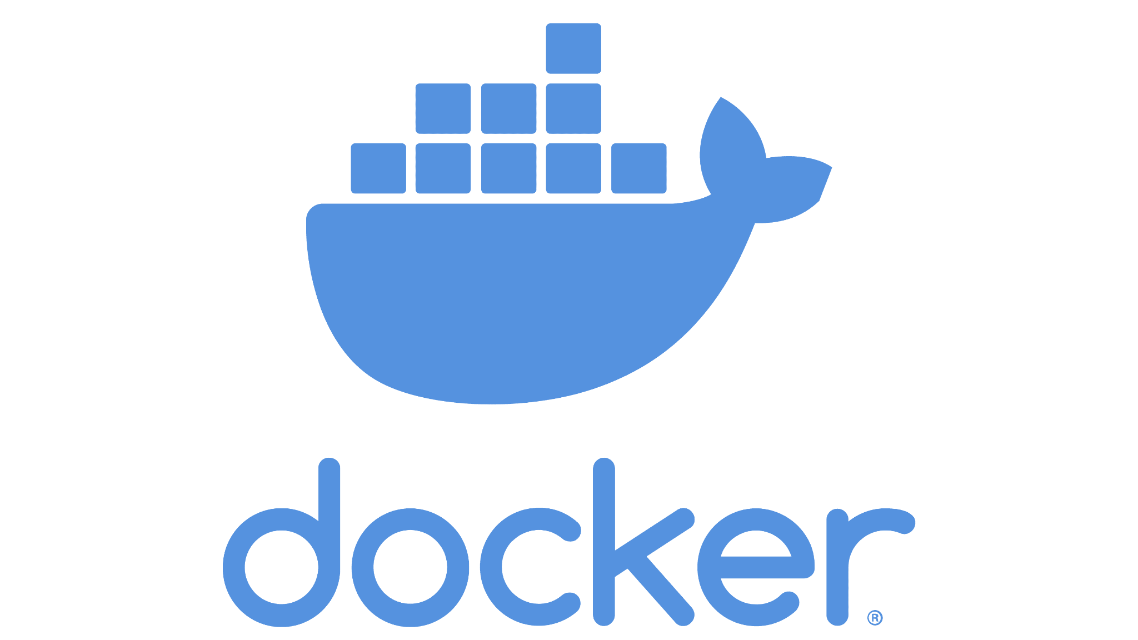
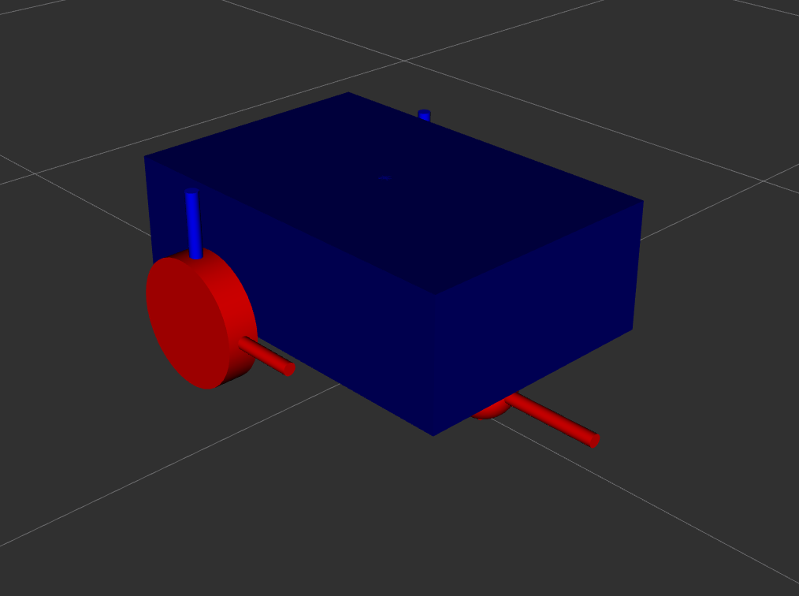
Where we ended up
Dockerized
ROS2
Car-like robot
Computer vision for dice identification
Joystick implementation
Gazebo simulation
Launch files

Slide 7
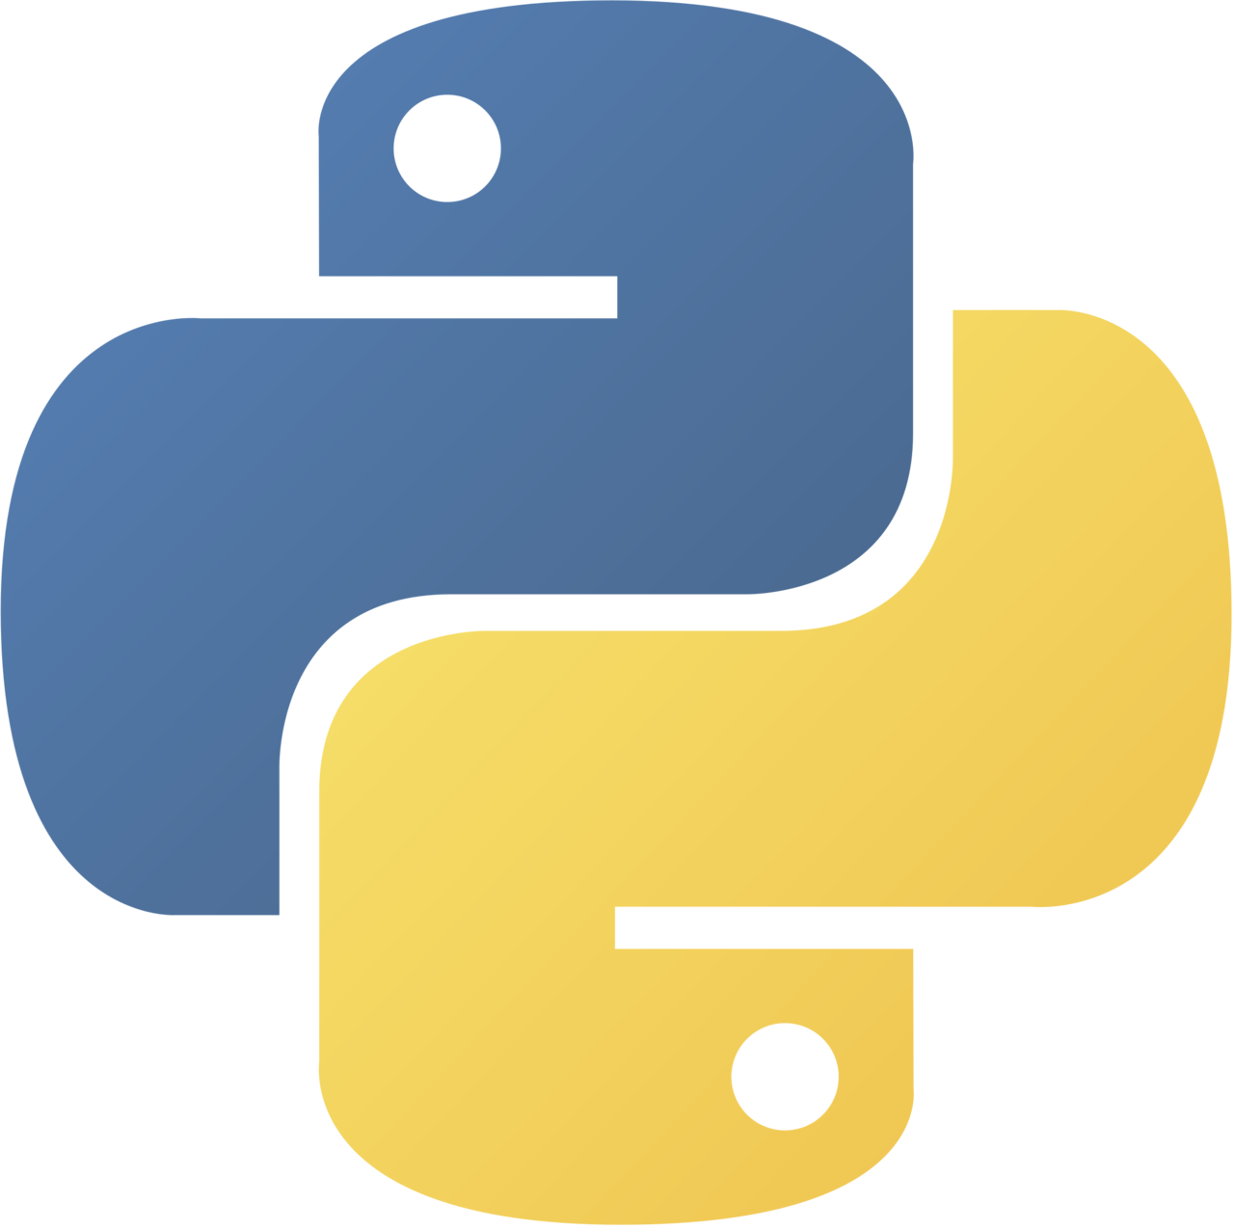

Docker
Ultralytics/YOLO requires old python libraries and wanted to use exclusively the system-level python, completely ignoring any virtual environments.
Docker solved all of our problems with getting the correct python libraries, and helped us make more robust packages.

Slide 8

Docker - more robust packages
Starting from a minimum container image - cannot assume all dependencies are downloaded
ROS2 has a tool called rosdep which can pull all necessary dependencies as long as they are ros related and declared explicitly in the package’s package.xml file
Configuring the Dockerfile to use rosdep and minimize explicit downloads forced us to make the packages more complete

Slide 9
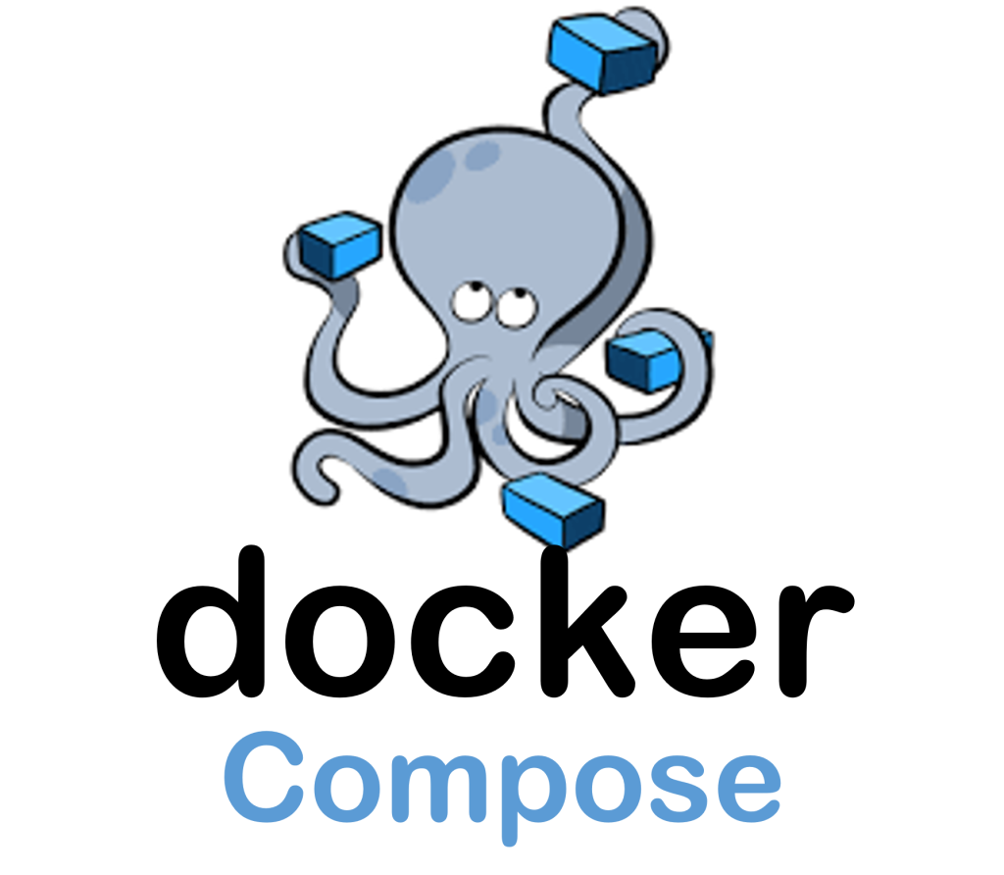
Docker - Docker Compose
Docker compose made it easy to map all our devices, displays, and directories from our host machine to the container
Allows us to easily have many terminal windows going to the same container
This was a big improvement in our ability to iteratively program

Slide 10
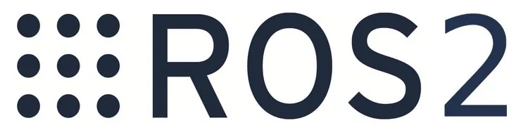
A brief overview of ROS2
ROS2 operates on a system of topics and nodes.
A node can publish to a topic, which any other node can listen to
Topics can be of any message type you want, but there are some built-in types for common use
int, float, arrays of ints/floats, Twist (linear and angular velocity), etc

Slide 11
ROS2 Graph
4 different subsystems:
Webcam
Joystick
Sensor Interpretation and Command (SIC)
Gazebo

Slide 12
Computer Vision - Webcam and YOLO
webcam_publisher:
publishes raw webcam data
dice_detector:
Reads messages with raw camera feed images,
Looks at the camera feed to determine the dice roll values using YOLO, and
Publishes the sum of the opposite faces
YOLO provided by Ultralytics python package

Slide 13
Controller
joy_node:
Listens to specified joystick seen by the operating system
dualsense_node:
Takes the raw joystick data, and publishes a simplified, trimmed-down set of data

Slide 14
Sensor Interpretation and Command
Connective tissue of our robot program
trigger_node:
Reads button states and dice sums to determine how the robot should move
Publishes velocity the robot should move at (linear, angular)
Velocity is (sum of opposite sides of dice) * (some scale factor)
ros_gz_bridge:
Reads the velocity instruction, translates the velocity information into joint state of the robot
Publishes it as /joint_states topic

Slide 15

Gazebo
The robot_state_publisher reads the urdf file information about the robot geometry, mass and inertia.
As it receives the real-time joint states information from the ros_gz_bridge, it publishes the transform message to gazebo.
The Gazebo simulator has plugins to specify behavior of the robot in the scene. It configures the joint state based of the robot type (left/right wheel for wheel robot) which enable Gazebo to simulate more accurately based on the robot type.

Slide 16
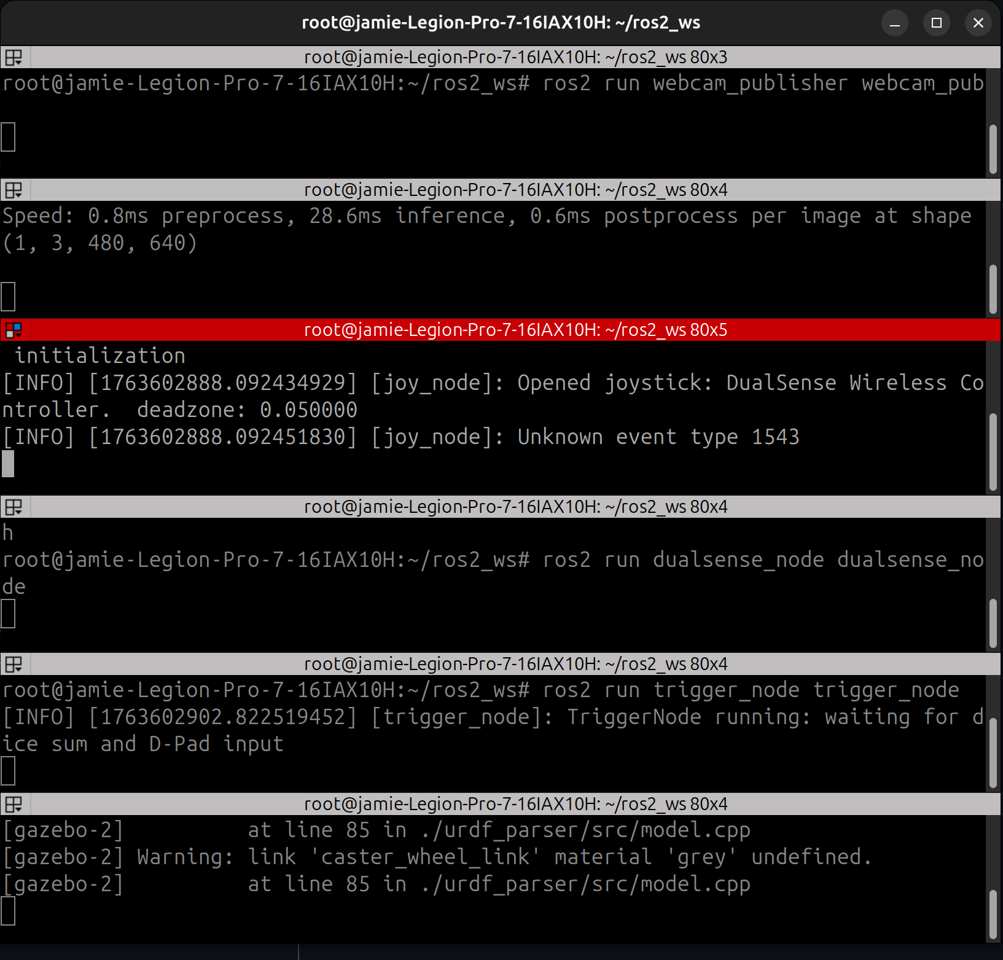
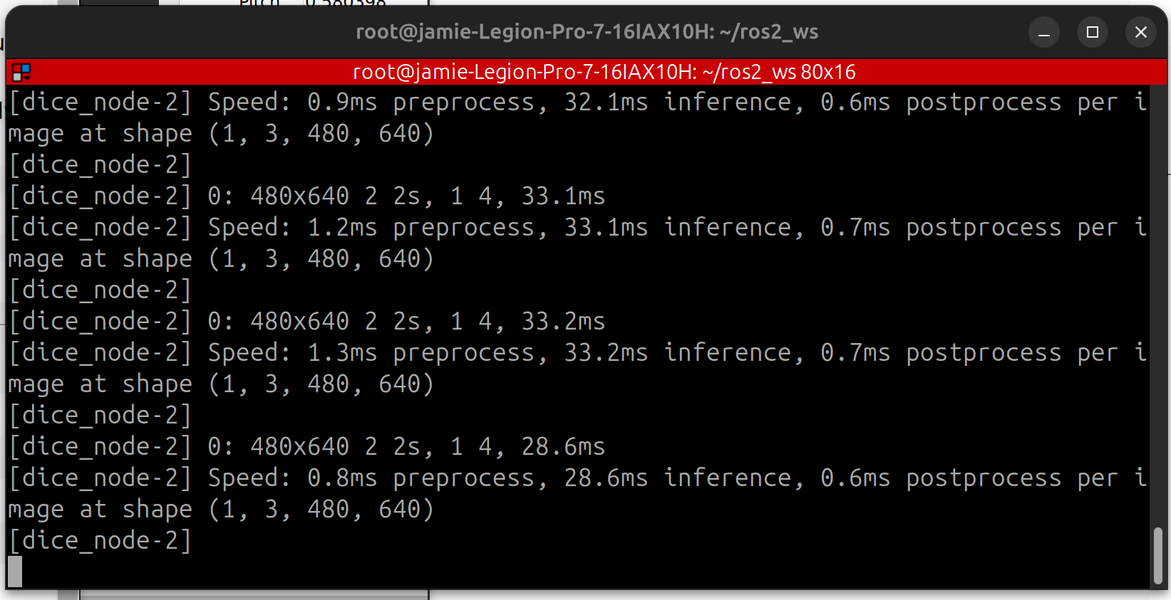
ROS2 Launch Files
Tired of opening 10000 different terminal windows to launch all your nodes? Use a launch file!
This is especially useful for our project because we were operating inside a Docker container
Six windows, six
commands vs
one of each!

Slide 17
Demo Time!

Slide 18
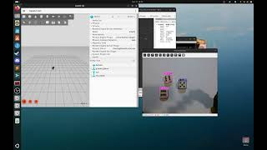
Demo Video

Slide 19

Lessons Learned
Use Docker
Don’t commit to hardware you aren’t familiar with, or may otherwise be unreliable. This is especially true for short-term projects such as this.
If you plan to use YOLO with ROS2, please start at this github repo:
https://github.com/mgonzs13/yolo_ros
Have well defined topics and message formats to enable easier parallel development if working with ROS2

Slide 20
Future Changes
Improve YOLO model - better dataset
Integrate with a more sophisticated robot, either in Gazebo or physical hardware
More sophisticated movements, more diverse set of outcomes
More feature-rich control scheme
Improve Dockerfile so that builds are faster

Slide 21
Questions?
Delegation of effort:
Jamie Moseley:
Docker, YOLO, Joystick, and Webcam
Yifan Shi
Gazebo and RVIZ config
Chia-Yen Tsou:
Integration and debug
Team 12: Tech-no Logic

